Slide 1


Loan Approval Prediction System using Python

Slide 2

Introduction to Automated Loan Approval
Manual Challenges
Crucial Process
Loan approval is a cornerstone operation in the banking and finance sector, directly impacting institutional stability and customer access to credit.
Traditional manual loan approval systems are often burdened by lengthy processing times, resource intensity, and a susceptibility to human biases, leading to inconsistent outcomes.
ML Transformation
Project Focus
Machine Learning offers a powerful solution, automating decisions, improving accuracy, and streamlining the entire process, making it more reliable and objective.
Our project specifically focuses on developing a predictive model that uses comprehensive customer data to determine the likelihood of loan approval or rejection with high precision.

Slide 3


Key Attributes for Loan Approval Prediction
The predictive power of our model hinges on a carefully selected set of attributes. These features provide a holistic view of the applicant's financial health and personal circumstances, enabling informed decisions.
Applicant Income
Co-applicant Income
Loan Amount
Loan Amount Term
Credit History
Gender
Marital Status
Education
Property Area
The Loan Status serves as our target variable, indicating whether a loan was approved or rejected, which the model aims to predict.

Slide 4


Technologies and Tools Utilized
Programming Language: Python
Python's versatility, extensive libraries, and strong community support make it the ideal choice for Python projects, enabling rapid development and deployment.
Key Libraries:
NumPy: Essential for numerical operations and array manipulation.
Pandas: Critical for data manipulation and analysis, especially with tabular data.
Matplotlib & Seaborn: Used for comprehensive data visualization and exploratory analysis.
Scikit-learn: The cornerstone for machine learning algorithms, model training, and evaluation.
Development Environment:
Jupyter Notebook / VS Code

Slide 5

The problem is to analyze loan application data to:
Understand loan approval vs rejection trends
Identify high-risk and low-risk customer segments
Analyze the relationship between income, loan amount, and credit score
Provide data-driven insights to support better loan approval decisions

Slide 6
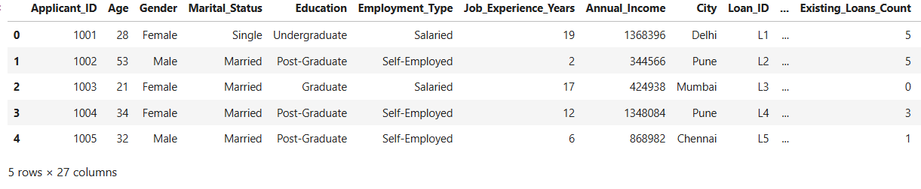
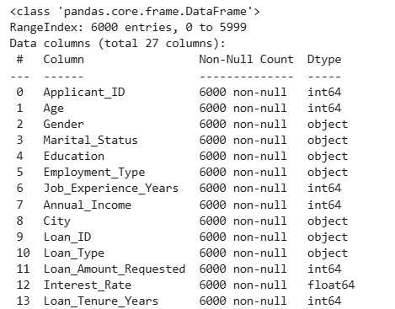
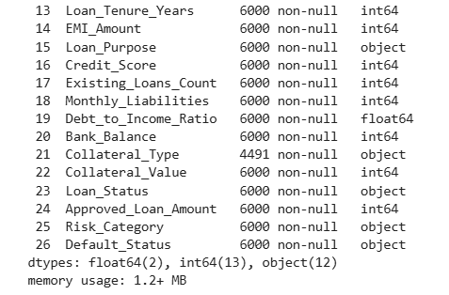
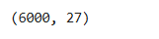
Dataset Overview

Slide 7



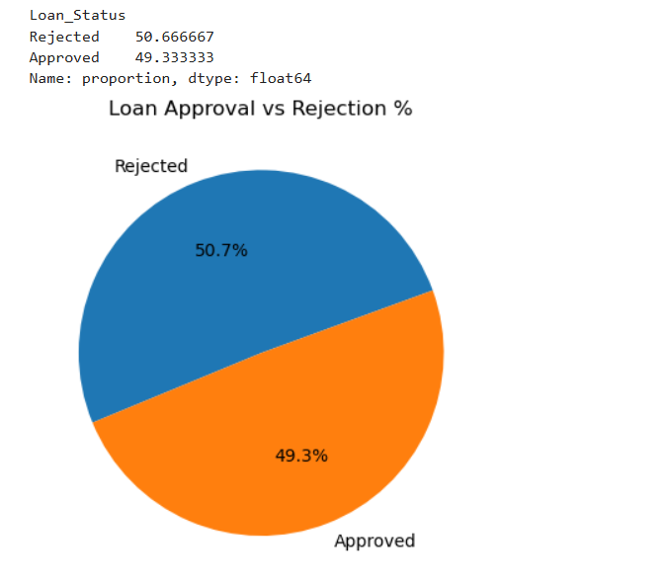
“This analysis shows the overall loan approval and rejection percentage in the bank.”
Loan approvals (49.3%) and rejections (50.7%) are almost equal.
This shows the bank follows a balanced loan approval policy.
Decisions are based on customer risk and financial profile.
There is scope to improve approval by targeting low-risk customers.

Slide 8

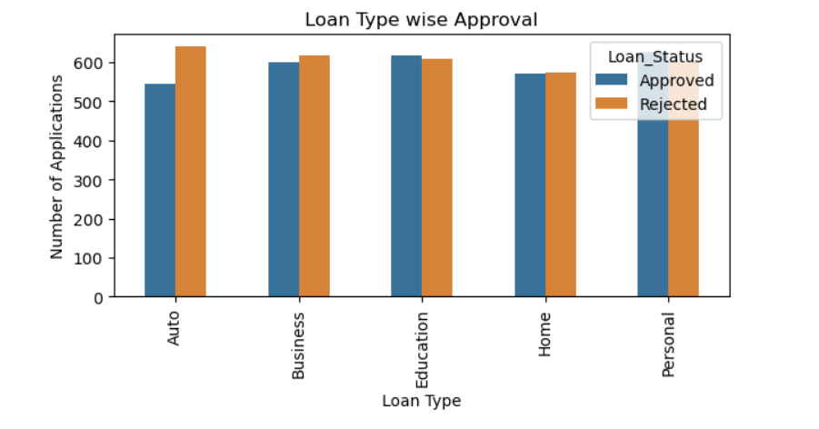
“I analyzed loan approval trends across different loan types.”
Home loans show higher approval compared to other loan types.
Personal loans have relatively higher rejection rates.
Approval varies significantly across loan categories.
Loan type plays an important role in approval decisions.

Slide 9
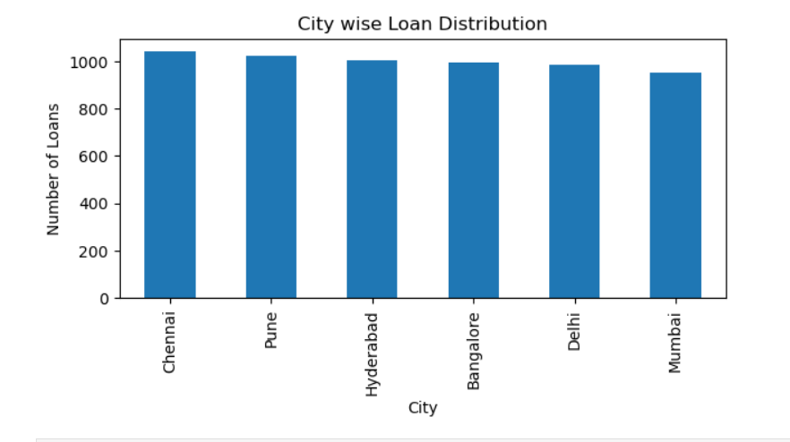

“This analysis shows loan demand distribution across different cities.”
Loan applications are higher in major cities.
Urban regions contribute more to loan demand.
City-wise trends highlight regional customer behavior.
Helps identify cities with growth potential.

Slide 10
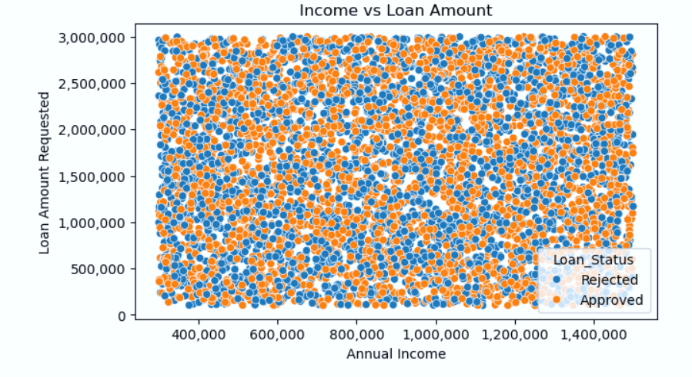

“I studied the relationship between applicant income and requested loan amount.”
Higher income applicants tend to request higher loan amounts.
Low income with high loan amount indicates higher risk.
Income is a key factor in loan eligibility.
Shows a positive relationship between income and loan amount.

Slide 11
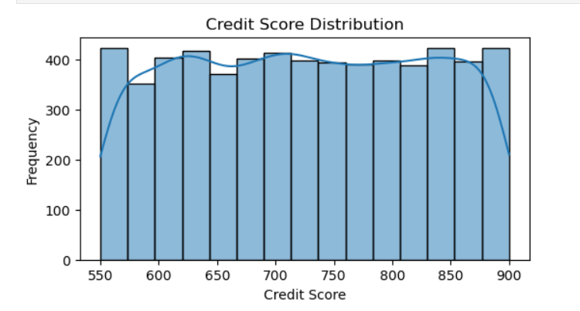

“This analysis highlights the credit score distribution of loan applicants.”
Most applicants fall within mid to high credit score ranges.
Higher credit scores are associated with better approval chances.
Credit score is a major risk assessment factor.
Distribution helps identify risky borrower segments.

Slide 12
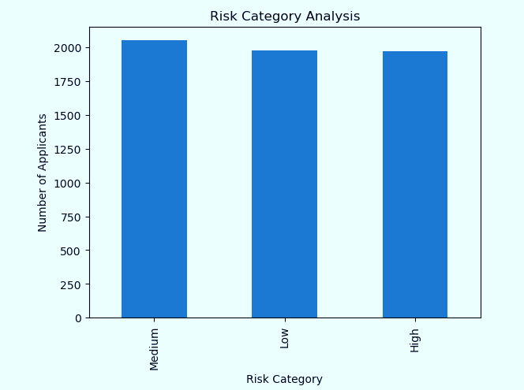

“I categorized applicants based on risk levels to understand bank exposure.”
Majority of applicants belong to low and medium risk categories.
High-risk applicants are fewer in number.
Risk category strongly influences approval decisions.
Helps banks control default risk.

Slide 13

Future Scope
The loan approval process is rapidly evolving with the adoption of AI and machine learning, making approvals faster, more accurate, and secure. Beyond traditional credit history, alternative data such as digital transactions and online behavior will be used to assess creditworthiness, making loans accessible to a wider population. Fintech platforms, digital lenders, and P2P models are expanding, creating a more inclusive and efficient ecosystem. Python-based projects can simulate and automate this process, showcasing the practical potential of data-driven, technology-enabled loan approvals.

Slide 14

Conclusion
This project analyzed banking loan application data using Python to understand loan approval trends and risk distribution. The analysis shows that loan approval decisions are strongly influenced by factors such as income, credit score, loan type, city, and risk category. These insights can help banks improve credit decision-making and manage risk more effectively.

Slide 15

Thank You

